Slide 1
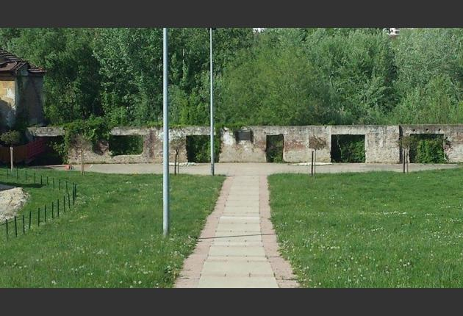
SUFFERING OF THE ROMA IN BELGRADE CONCENTRATION CAMPS AND PRISONS
dr Dragoljub Acković Beograd, 2017.

Slide 2
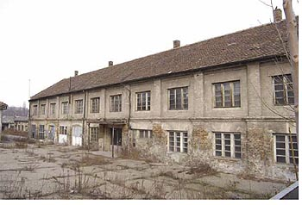
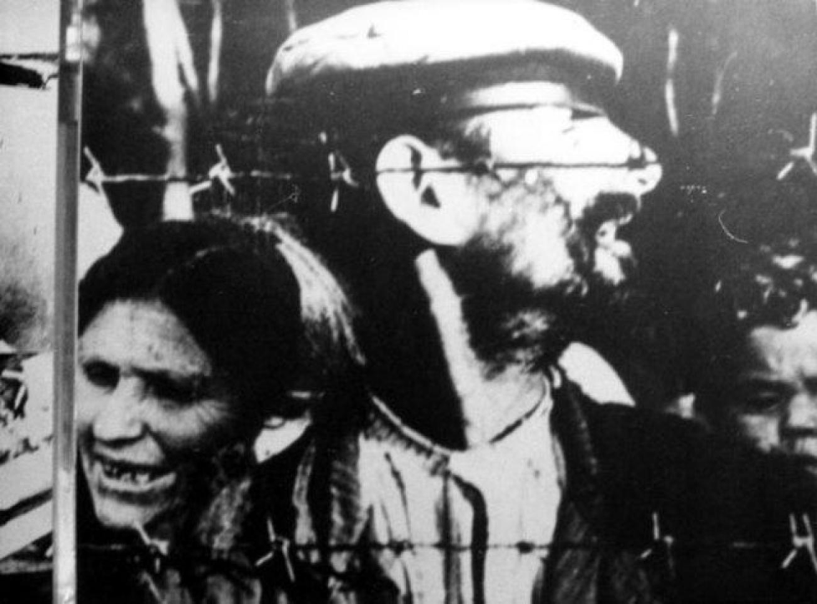
The death of Belgrade Roma began in Topovski sheds
Since the first moment of the German attack against Serbia, up to the final break up of the fascist and collaborationist forces, for the Roma in Serbia, as well as all over the world, began the most difficult period of their thousands of years long suffering. The basic component with which te Roma from all parts of the globe had been living, since Hitler‘s arrival, was the fear for their barest lives.
Well beofore the Germans appeared in Belgrade, the Roma and Jews from this city knew what the occupier intended to do with them. They did not have to wait long, in order to feel the same, on May 22, 1941 in the Order Notice no 5. of the Military commander for Serbia, the second article of which read: A permit for conducting the job of editor can only be granted if the person is not a Jew or Gypsy, or is not married to a Jewish or Gypsy woman. (The Orders notice is kept in documents 1/I-III at the VII archives, all the abovementioned are listed under their respective numbers).
The Orders notice is kept in documents 1/I-III at the VII archives, all the abovementioned are listed under their respective numbers.
Roma in prison camps

Slide 3
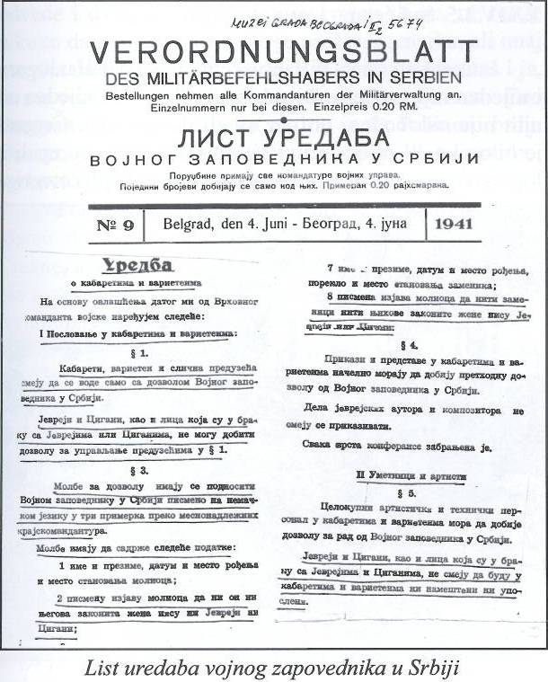
List of military commanders in Serbia
Some other lorders concerning the Roma and Jews were also brought to light in the same Order Notice: Article 2 „Of the order for managing a theater“- art. 3 speaks about issuing permits for running the same: A Jew and Gypsy, as well as persons married to the same, cannot obtain permits for leading theaters. The already mentioned regulation also says that applications for work permits for managing theaters are to be submitted in triplicate written in German, to the milatary commander in Serbia, and the same must contain data listed in paragraph 8 of this aricle, where they state that even their wives are not Jewish, in other words Gypsy.

Slide 4
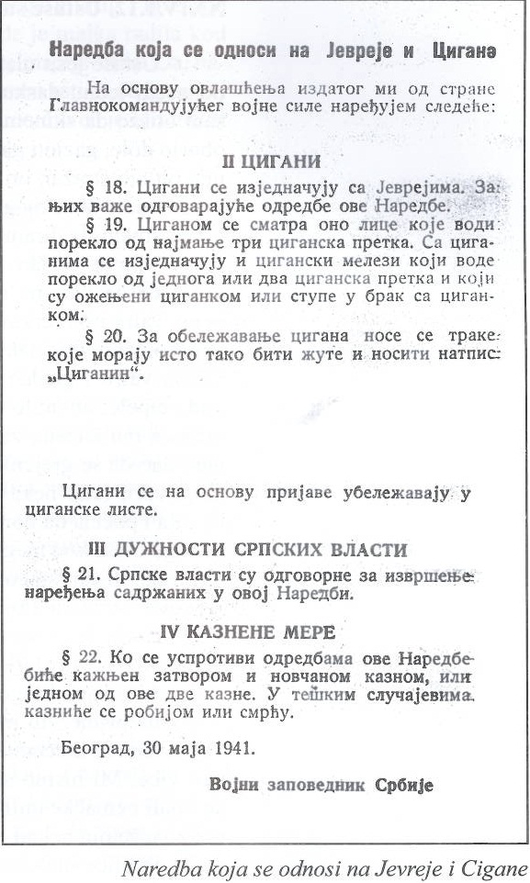
An arrangement for the Roma and Jews
The second part of art.5 of this order also states: A Jew and Gypsy as well as persons married to Jews and Gupsies (Document of the state committee for determining war crimes of the occupiers and their assistants. INV no. 11291 Archives V.I.I. 8/2-1.), cannot work nor be employed by companies (referring to theaters). It is also underlined that this regulation, issued on May 20, 1941 be in effect retroactively beginning May 1, 1941. The third paragraph of article 2 – Regulations on the work of movie theaters and movie rentals says: The Jews and Gypises, as well as persons married to Jews and Gypsies cannot obtain work permits for running movie theaters, contain the applicant‘s, or his assistant‘s written statement that neither he nor his wife are Jewish or Gypsy (paragraph 2), while paragraph 9 of the same article provides for the written statement which must also contain the information that neither the assistants nor theri wives are Jewish or Gypsies.

Slide 5
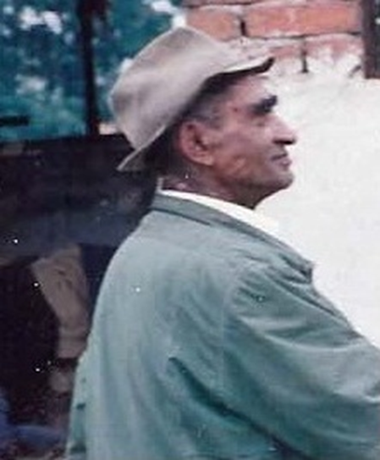
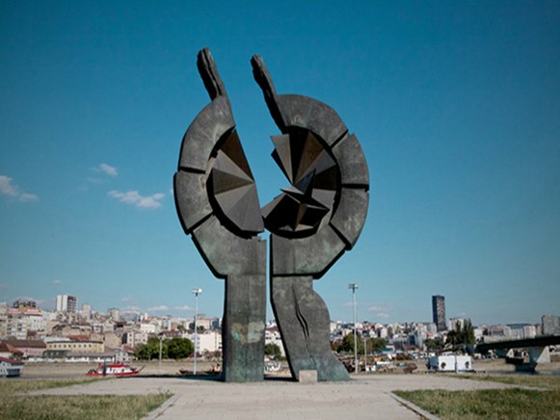
A survivor from the Sajmišta, Branislav Acković survived
Art. 7 of the cited Regulation states: Jews and Gypsies as well as person married to Jews and Gypsies in principle are excluded from jobs in companies concerned with movie rentals. Although this regulation was brought on May 20, 1941, its article 13, regulates its effectiveness beginning with May 1 1941. Article 2. of the Regulation on Cabarets and Variety shows“ states that Jews and Gypsies as well as persons married to Jews and Gypsies cannot obtain a working permit for running the same. Paragraph 2 of article 3 provides that applications for running cabarets and variety shows must also contain: A written statement of the applicant that neither he nor his legal spouse are Jewish or Gypsies, and paragraph 8 of the mentioned aricle also provides for a written staement by the applicant which states:“ That neither the assistants not their legal spouses are Jewish or Gypsies. The second part of this regulation which concerns artists states: Jews and Gypsies as well as persons married to Jews and Gypsies cannot be retained by cabarets or variety shows.
Camp Old Fairground

Slide 6
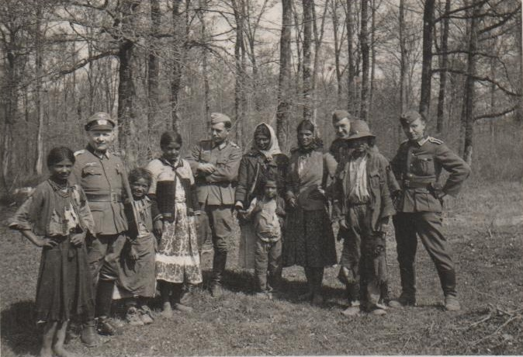
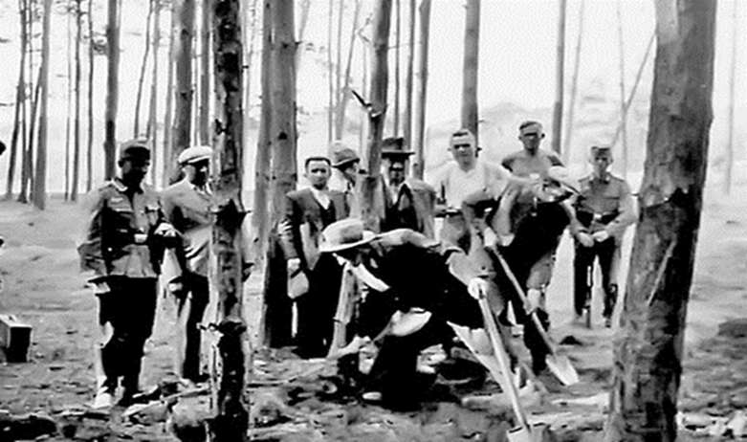
German soldiers with Roma who may shoot
On the last day of May 1941, in the Notice of Regulations of the military commander for Serbia no 8. proclaimed the Order which concerns the Jews and Gypsies). The second part of this order concerns exclusively the Roma. Its article 18 states: Gypsies are assimilaterd to Jews. For them pertaining regulations of this Order are effective. Everone is familiar with what is provided for the Jews and by that the Roma as well, thus we need not list them. Art 19 states: A Gypsy is considered that person who is a descendednt of at least three Gypsy ancestors. Even the Gypsy half-breeds with one or two Gypsy ancestors, and who are married to a Gypsy or are about to marry one, are also assimilated with Gypsies.
Shooting an unknown Roma

Slide 7
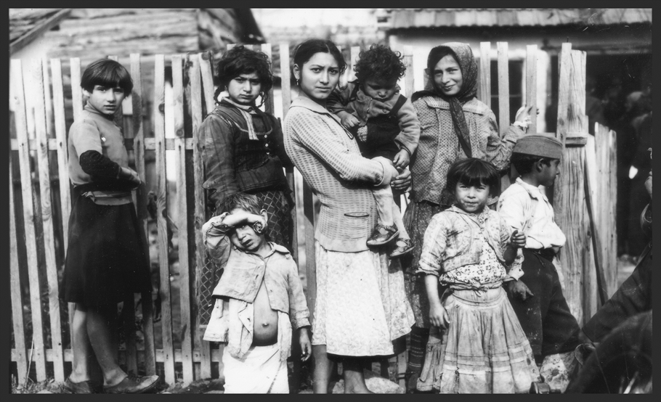
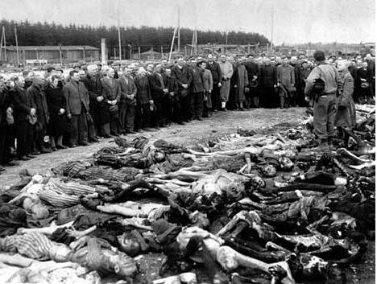
Roma family in Jatagan Mali
Art 20. states: For marking Gypsies, arm band must be worn which must also be yellow and carrying the insignia „Gypsy“. Based on registration, Gypsies are to be entered in Gypsy lists. Sanctions for not respecting this Regulation are provided for in art 22 which states: Whoever disrespects the regulations of this Order will be punished by imprisonement of fine. In more serious cases they will be sentenced to hard labor or death.
Shooting Banjik detainees

Slide 8
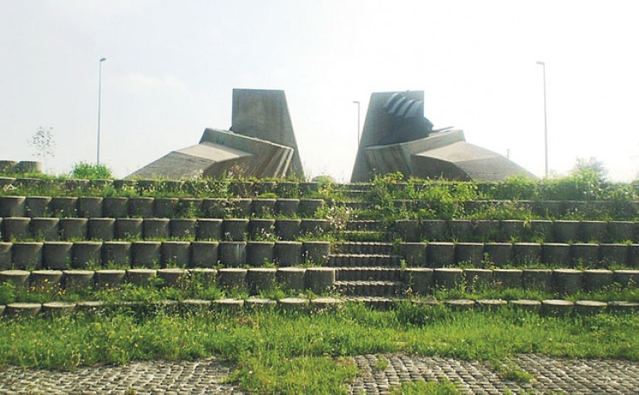
The memorial area of the camp of Jabuka, where many Roma from Belgrade were killed
The day of Hitler‘s attack on the USSR, on July 22, 1941, a Regulation to suppleme-
nt trhe abovementioned Order which concerns the Jews and Gypsis dated Maj 30, 1941.(Same,m INV no. 11291 Archives V. I.I. 9/2-1.), which was not published in the Paper of Orders of the milatery commander for Serbia dated 25 july 1941, and which even more drastically regulated all the significant issues concerning the life and employment of the Roma and Jews.
Everyday life in the Belgrade Jatagan Mali

Slide 9
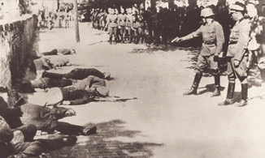
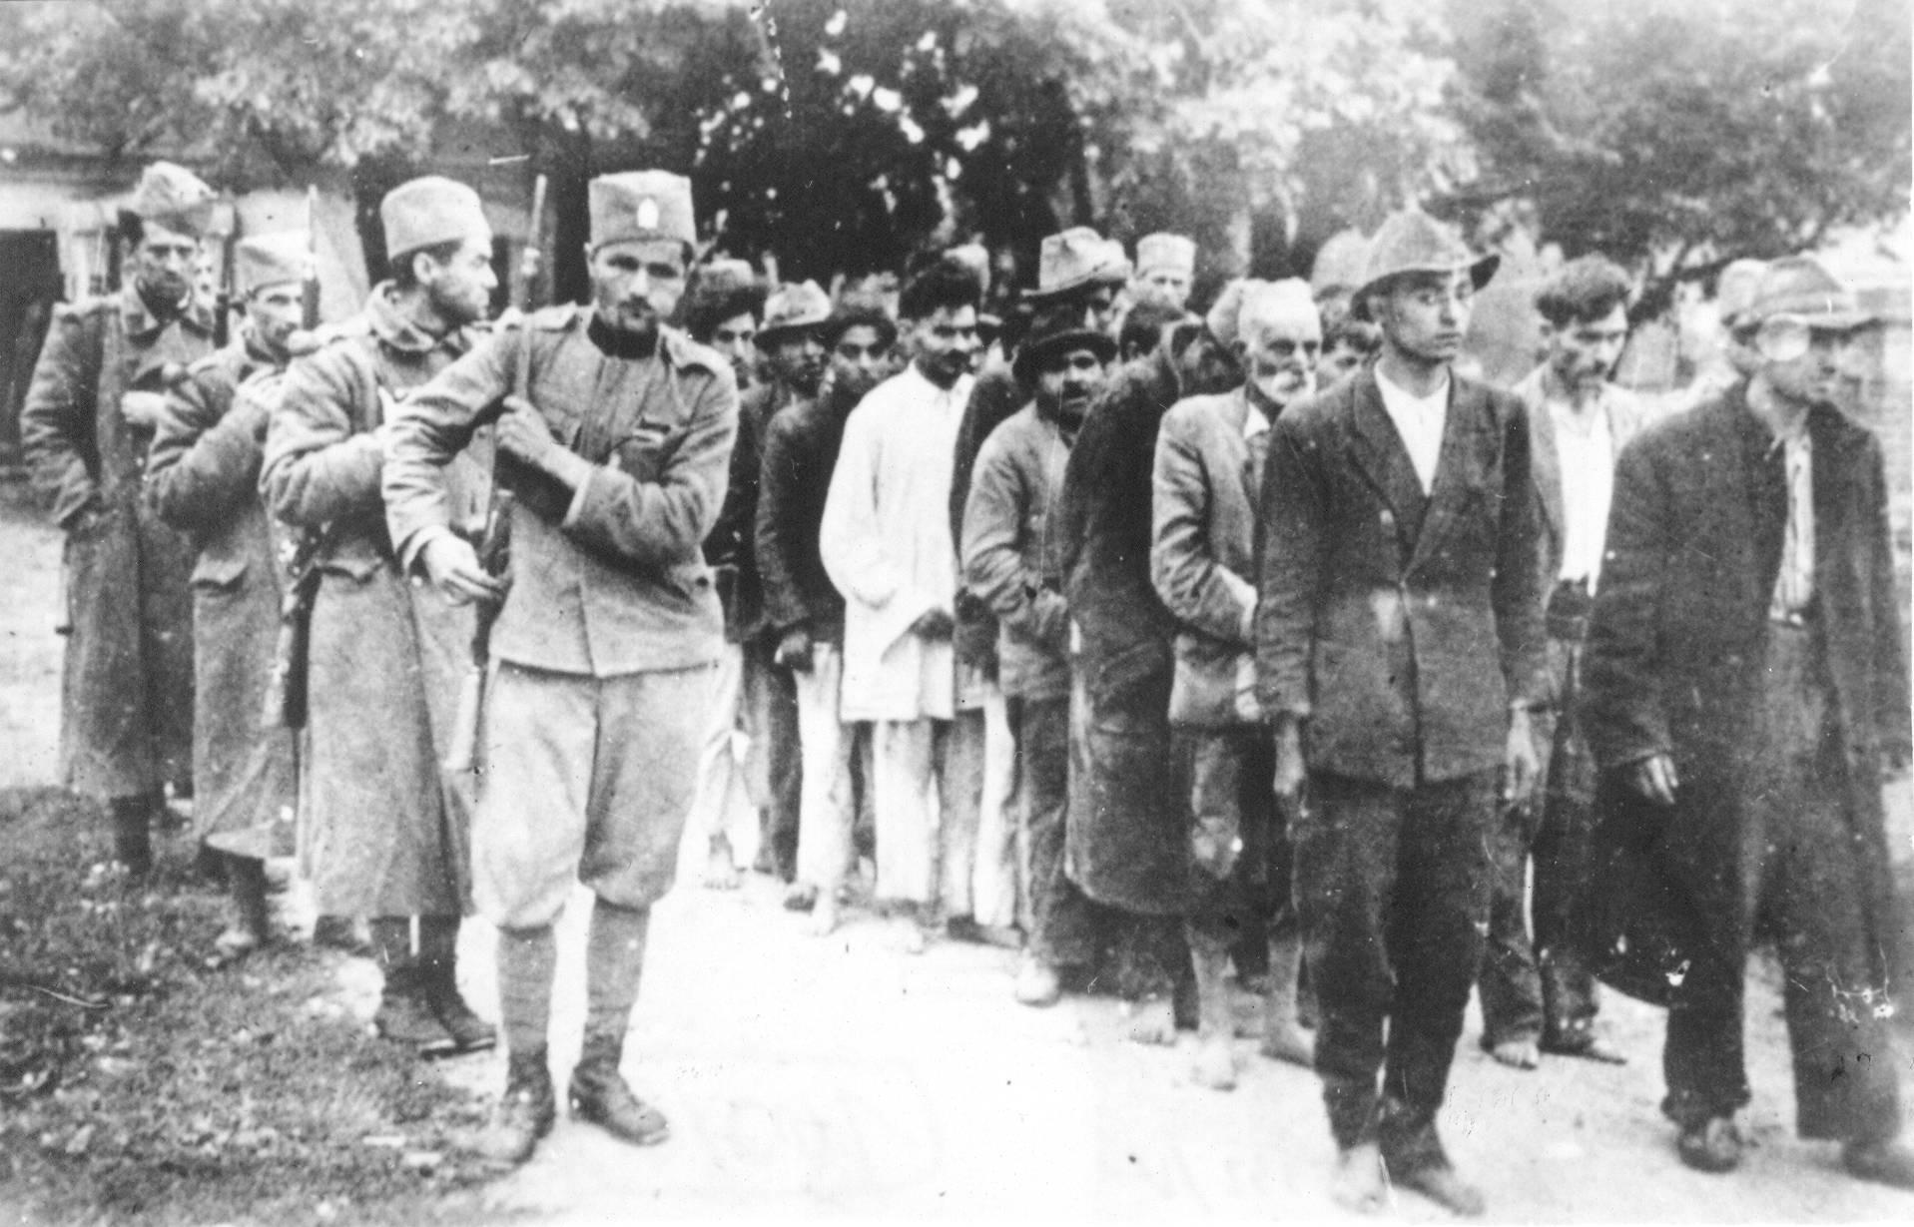
The fascists are shooting
Although the Order (Doc. At V.I.I. 40/1, k.27/2, German Archives.), that all the Gypsies and Jews be arrested in Belgrade as hostages, came only on November 3, 1941, with the dead line for its implementing set for November 15,1941. The arresting and executing of the Roma occured as soon as Hitler‘s people enetered Belgrade. The abovementioned Order was never fully implementerd, although such a notice was sent to Berlin towards the and of 1942, although even its parial implementation had taken many thousands of Roma victims.
Conducting Roma from Sabac to Log Fair

Slide 10
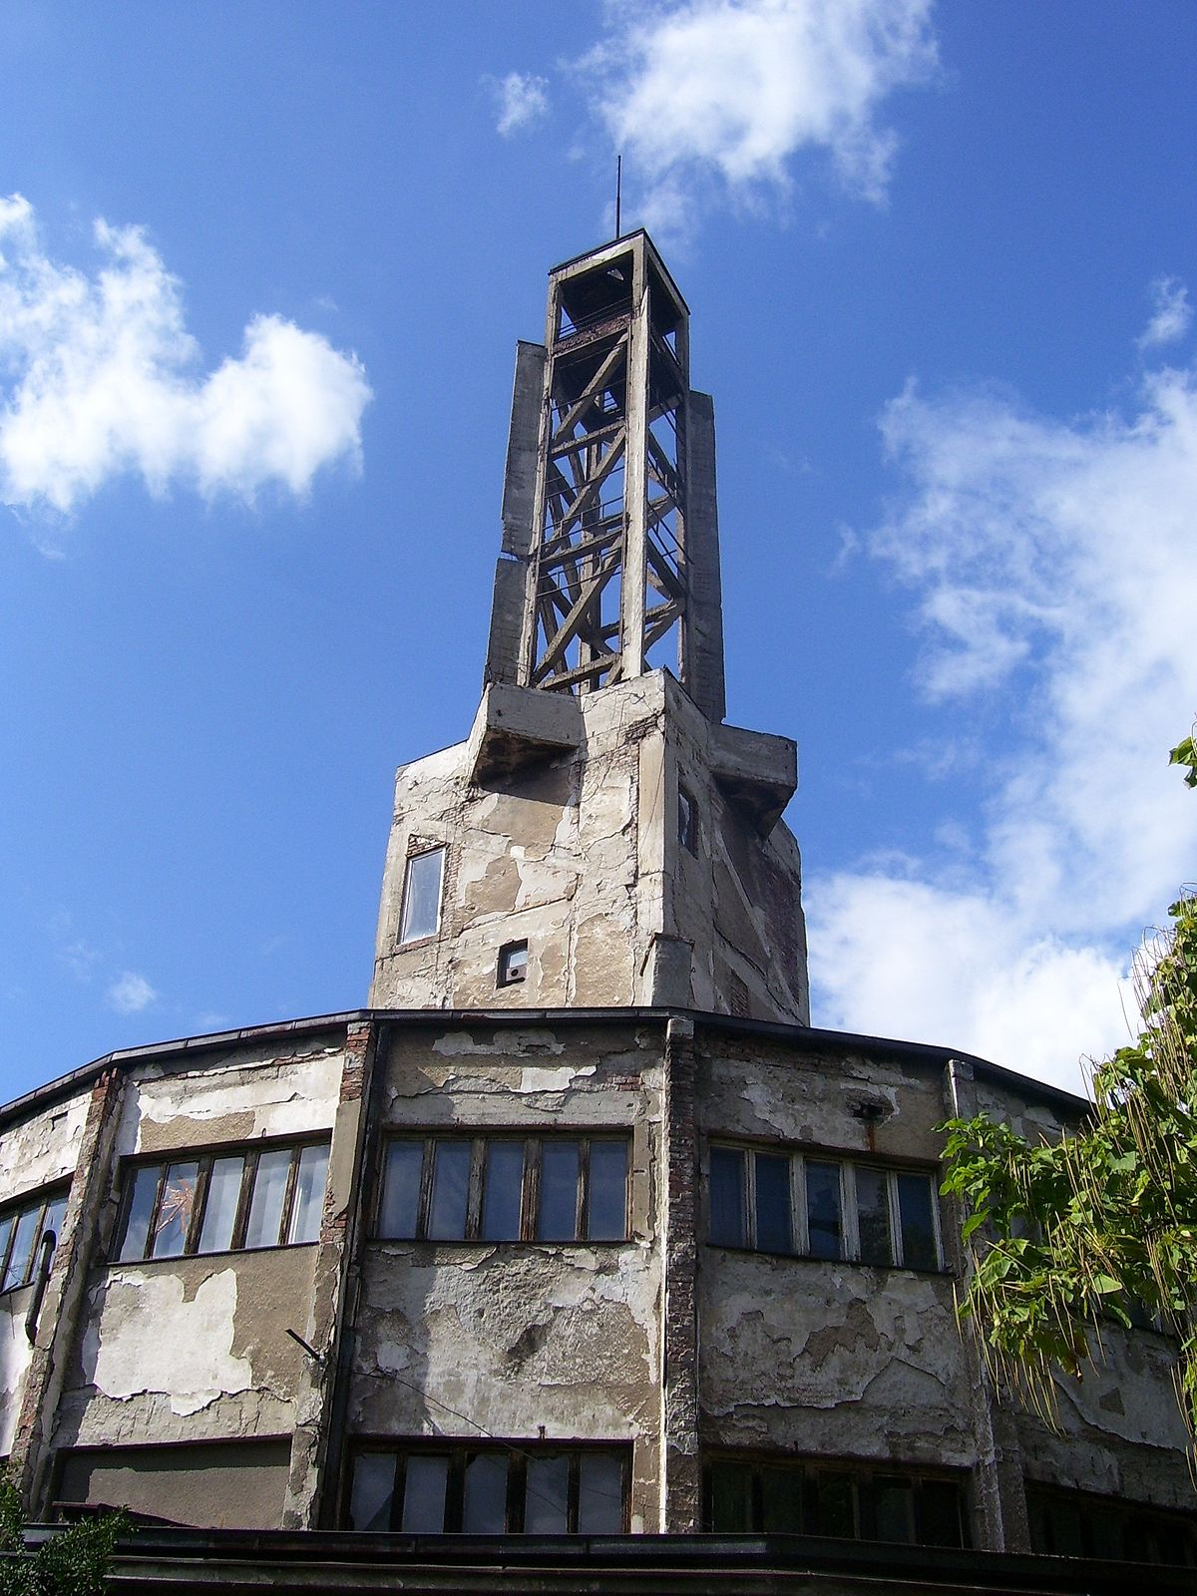
Collaborationist forecs in the occupied territories, extended great assistentance in the implementing of this German Order, although it could be said with certainty that a number of the Roma for demagogue and utilitarian reasons thanks to those forces were saved from certain death. A little less during the first months of the occupation and a little more later, the quisling newspapers wrote about the arrests of this population. Under the title „Gypsies fight at the market in Obrenovac“, the newspaper Novo Vreme, on Thursday August 7, 1941 reported that two Roma were arrested for fighting at the market in Obrenovac. Those days the Ministry of social services and national health Commissioner, Stevan Ivanic in a interview for The Novo Vreme newspaper implied: That preparations be made, for estabilihing a separate Institute for racial and biological research and the protection of our (referring to the Serb population) from all the bad influences of inheritance and irregular marriages (Novo Vreme, Aug 19, 1941, pg 3.). It is known thoughout the world for what purposes and how those Institutes wre used.
The infamous tower in the Sajmište camp

Slide 11
A memorial for Dekic Cvetka from Mirijevo
The Roma from Belgrade and its vincinty were most frequently taken to the death camp“ the Banjinca camp. The exct number of the Roma who passed through it will never be determined. Still, some information exists. Two mounths after its opening (opened July 5, 1941, with the first group of men brought in five days later, while the first group women was brought in July 16), September 13, 1941, the first group of inmaters was brought in for whom it is know lfor certain that they were Roma. The Banjica death camp inmate under numer two houndred ninteen (Belgrade city Administration, Banjinca Concentracion camp. Inmate personal infomation register for 1941 no. 1-1000. UGB INV no. 195/SP-4 Belgrade archives.), was Živojin T. Marinković, an ordinariy woreker, born in 1915 in the village of Meljak near Belgrade, to parents Trisha and Mileva, maiden name Todorović, spouse to Danica, father of two children Sveta and Sava (Gypses).

Slide 12
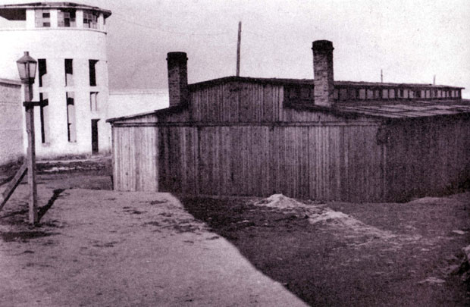
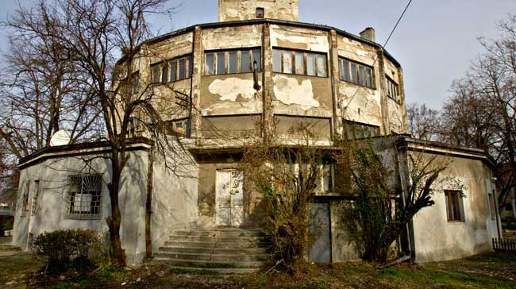
Camp at Sajmište
He came to the camp 13.9.1941. He was brought in from Umka. He was executed in Belgrade September 16,1941. Along with him on September 13 the folowing were also brought in: Živojin M. Marinković(220), Mladen M. Marinković (221), Dimitrije M. Marinković (222), Spasoje Marinković (223), Živojin Marinković (224), Dušan Mirković (225), Milan Mirković (226), Milan Stanković (227), Dušan Stanković (228), Miladin Stanković (229), Cvetko Stanković (230), Borivoje Stanković (231), Milan Radosavljević (232), and Stanoje Todorović (233)(The numbers beside the names are those under which the persons were listed in The mentioned persnal information register.).
This group of Roma was executed at the same time as the abovementioned, on September 16, 1941. They were all from the village Umka near Belgrade. According to the last names there were many close relatives among them.
Camp at Banjica

Slide 13
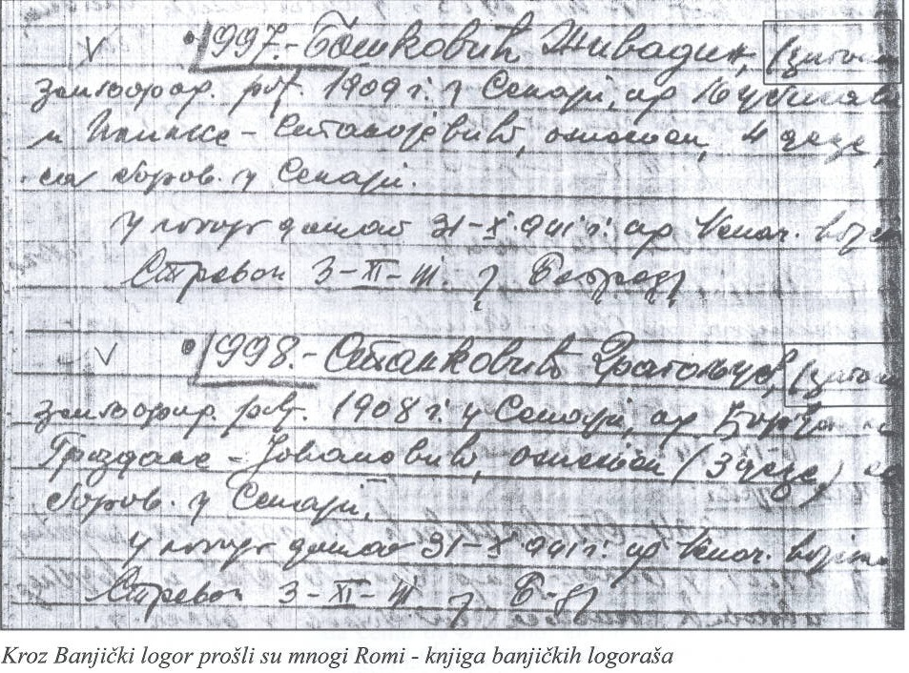
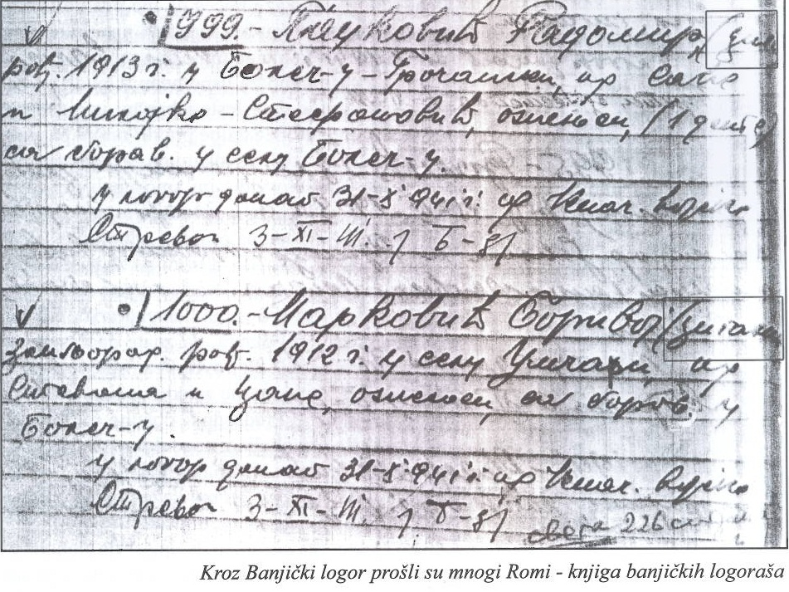
Books of Banjički detainees
On October 11, 1941 on behalf of the Belgrade administration a group of Roma from Sremčica were arrested and brought to the Banjica camp (that is te second group of inmates for whom it known with certainty that they were Roma). This group included: Nikola Marinković (829), Milorad Marinković (830), Dragomir Marinković (831), Vitomir
Marinković (832), Milan Radosavljević (833), Živojin Marinković (834), Jovan Radosavljević (835), Zlatomir Radosavljević (836), Dragomir Marinković (837), Markko Mitrović (838), Jovan Marinković (839), Miloje Mitrović (841), Sava Jovanović (842), Aleksandar Radosavljević (843)(The numbers beside the names are those under which the inmates were listed in The mentioned personal infomation register of the Banjica camp, UGB. INV no 195/SP-4 Belgrade archives.).

Slide 14
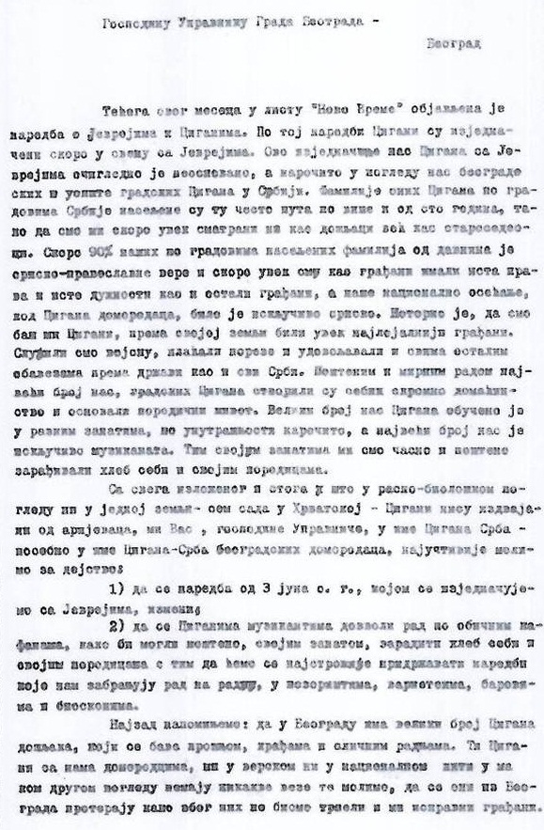
Letter from Belgrade Roma to the city administration manager
This group of Roma from Sremičica which was brought to the Banjica camp on October 11, 1941 was executed on October 17, 1941. The thgird group of Roma from Sremčica, was brought in October 16. A number of the members of that gruop were executed on October 24, while some of them wre relesed the same day they were brought in. The folowing group of Roma which was brought to the Banjica camp came from a little village Vojska near Belgrade. That group was brought in on October 18, 1941 and they spent about a month at the Banjica camp. No one from this group was executed, instead they were released on October 26, 1941 (or those days). According to our presumpions they were not executed because they spoke Romanian, and presented themselves as being Romanian, thus saving theri lives.

Slide 15
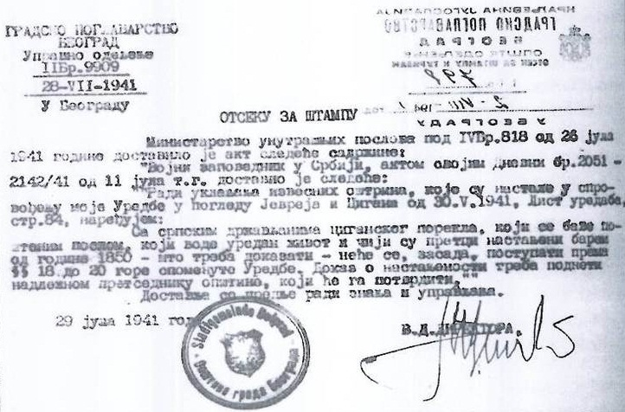
Camp Topovske shed
1.As far as the Roma in Belgrade who speak Romanian are concerned, it must be said that during the war they pretended to be Romanian and not Roma, which they do even to day, so that they would be spared the wrath of the occupier. Accoring to Sava Sremčević from Belgrade members of this family were sent to the camp on Autokomanda, but all were released after municipal autohorities issued them cerificates that they are not Roma but Romanian. After having obtained appropriate In November 1941, Belgrade police chief, Dragi Jovanović called musician Zdravko Milosavljević from Belgrade, and asked him to take up maintaining peace and order among his compatriots, and in return he promised him that there would no longer be arresting of Roma. As many others, Dragi issued certificates so that this group did not even have to wear yellow arm bands, which were compulsory for the Roma.
Act on Procedures for Roma in Belgrade

Slide 16
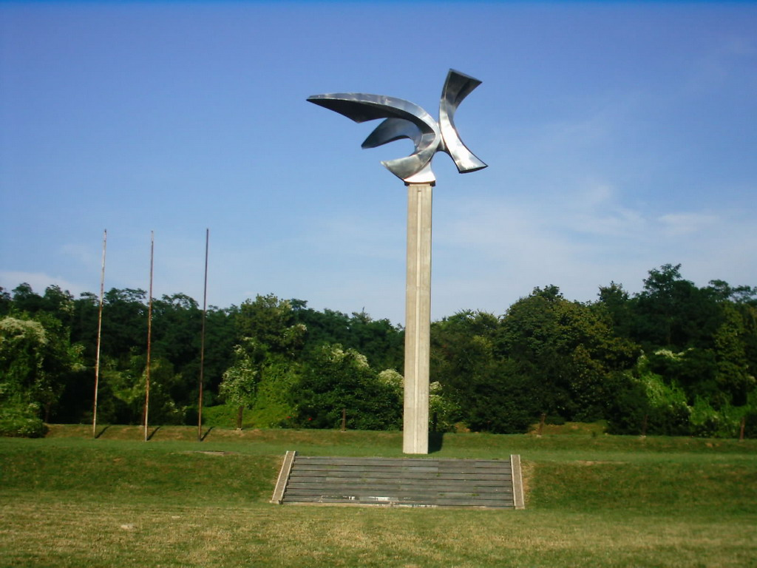
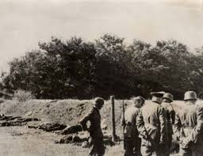
Monument to the victims in the Jajinci
A number of the Roma were relesed from the Banjica camp because of various interventions, and some of them after receiving certificates about their Arian or other belonging. Such certificates were issued by municipal presidents for a good fee.
Jovanović did not keep this promise either, but even if he wanted to he could not.
Collection camps on Autokomanda, and the camp on the Kraljević Andreja street, were places where the Belgrade Roma were taken to and later sent in diffeerent directions. The archives of these camps are incomplete and according to what can be found in the Belgrade archives, apparently only forty Roma passed through these collecitve camps, which is practically a radiculous number. When it is known that all the arrested Roma from Belgrade had to pass through these camps, just then a picture can be created of the number of Roma which had to have spent some time in them. Let us quote one example: at the beginning of November 1941, about a thousandd Roma were arrested and imprisoned in these camps.
Shooting Roma in the Jajinci

Slide 17
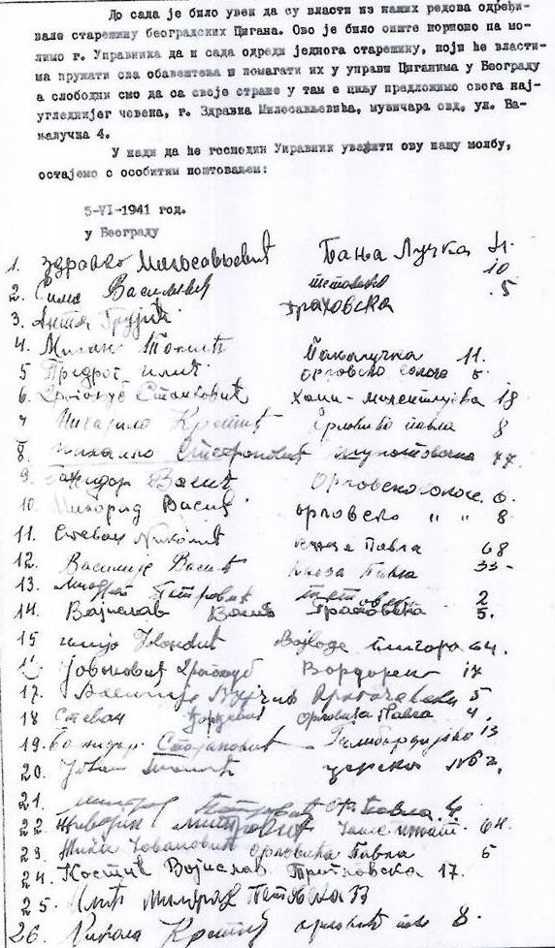
The petition of the Belgrade Roma mayor of Belgrade
The largest places of execution for the Roma in Belgrade were Banjica and Jajinci, and outside Belgrade, but in its vicinity Jabuka – a village near Pančevo. The number of Roma who suffered in Jajinci and Jabuka will never actually be known, since the archives were destroyed.
Having realized that the situation concerning the arrests and wxecutions of their compatriots is not improving a delegation of Belgrade. Roma requested an audience with the president of the quisling government, Milan Nedić. According to Sima Vasiljević (One the founders of the Belgrade Gypsy association, who worship Aunty Bibi, born 1908, presently living in Belgrade.), the delegation included: Ante Grujić, Mihajlo Stevanović, Zoran Stefanović, Djordje Simić, Djura Djordjević, Hristifor Jovanović and Marko Vasiljević. Milan Nedić received them, as a delegation of citizens, not a delegation of Roma. Nedić recognized Ante Grujić who was a soldier in his unit during The First World War. On that occasion Grujić informed him about the problems of the Roma and Nedić suggested that they obtain cerftificated from the municipal authorities that they were Serbs, and not Roma. In that manner another group of Roma from the camp were saved.

Slide 18
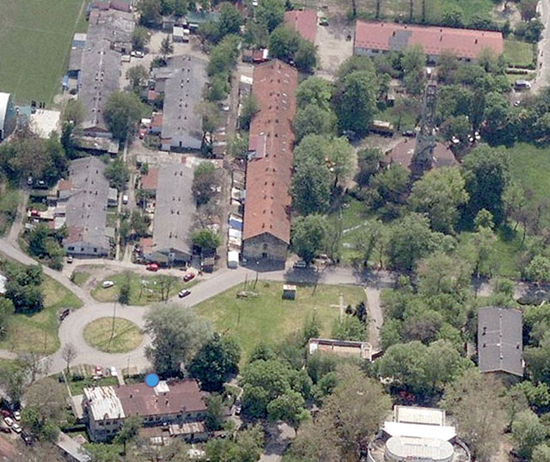
your attention
It was a story about the killing of Belgrade Roma.
Glory to the dead Roma Their successors
Thank you for your attention

